Slide 1
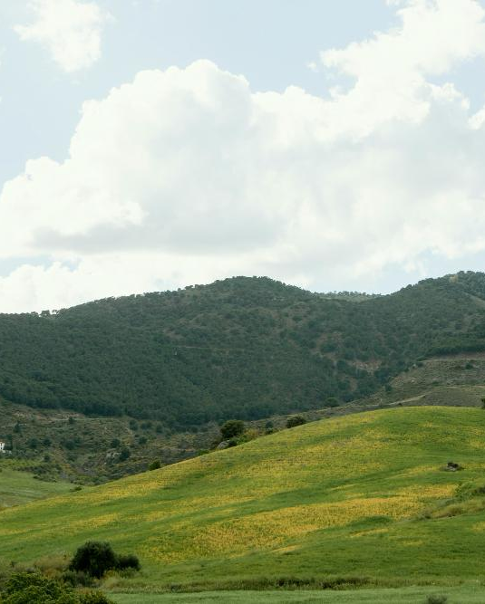
AgriSaral
Empowering farmers with smart solutions
By Team: DVTR

Slide 2
CONTEXT
Ever wonder why certain crops of the same variety grow in different regions ?
Like the Kesar mango in Gujarat and the Rajapuri in Maharashtra,
That’s due to the difference in type of climate and soil in terms salinity, nutrient level , ph level and many more

Slide 3
The Problem
Farmers face a lot of problems with regards to soil testing, like:
Not able to do soil testing for cheap
finding good fertilizers for the soil
finding good quality seeds compatible to the soil
Finding correct information about cropping methods
The Most Important –Finding Information in their Local language!!

Slide 4
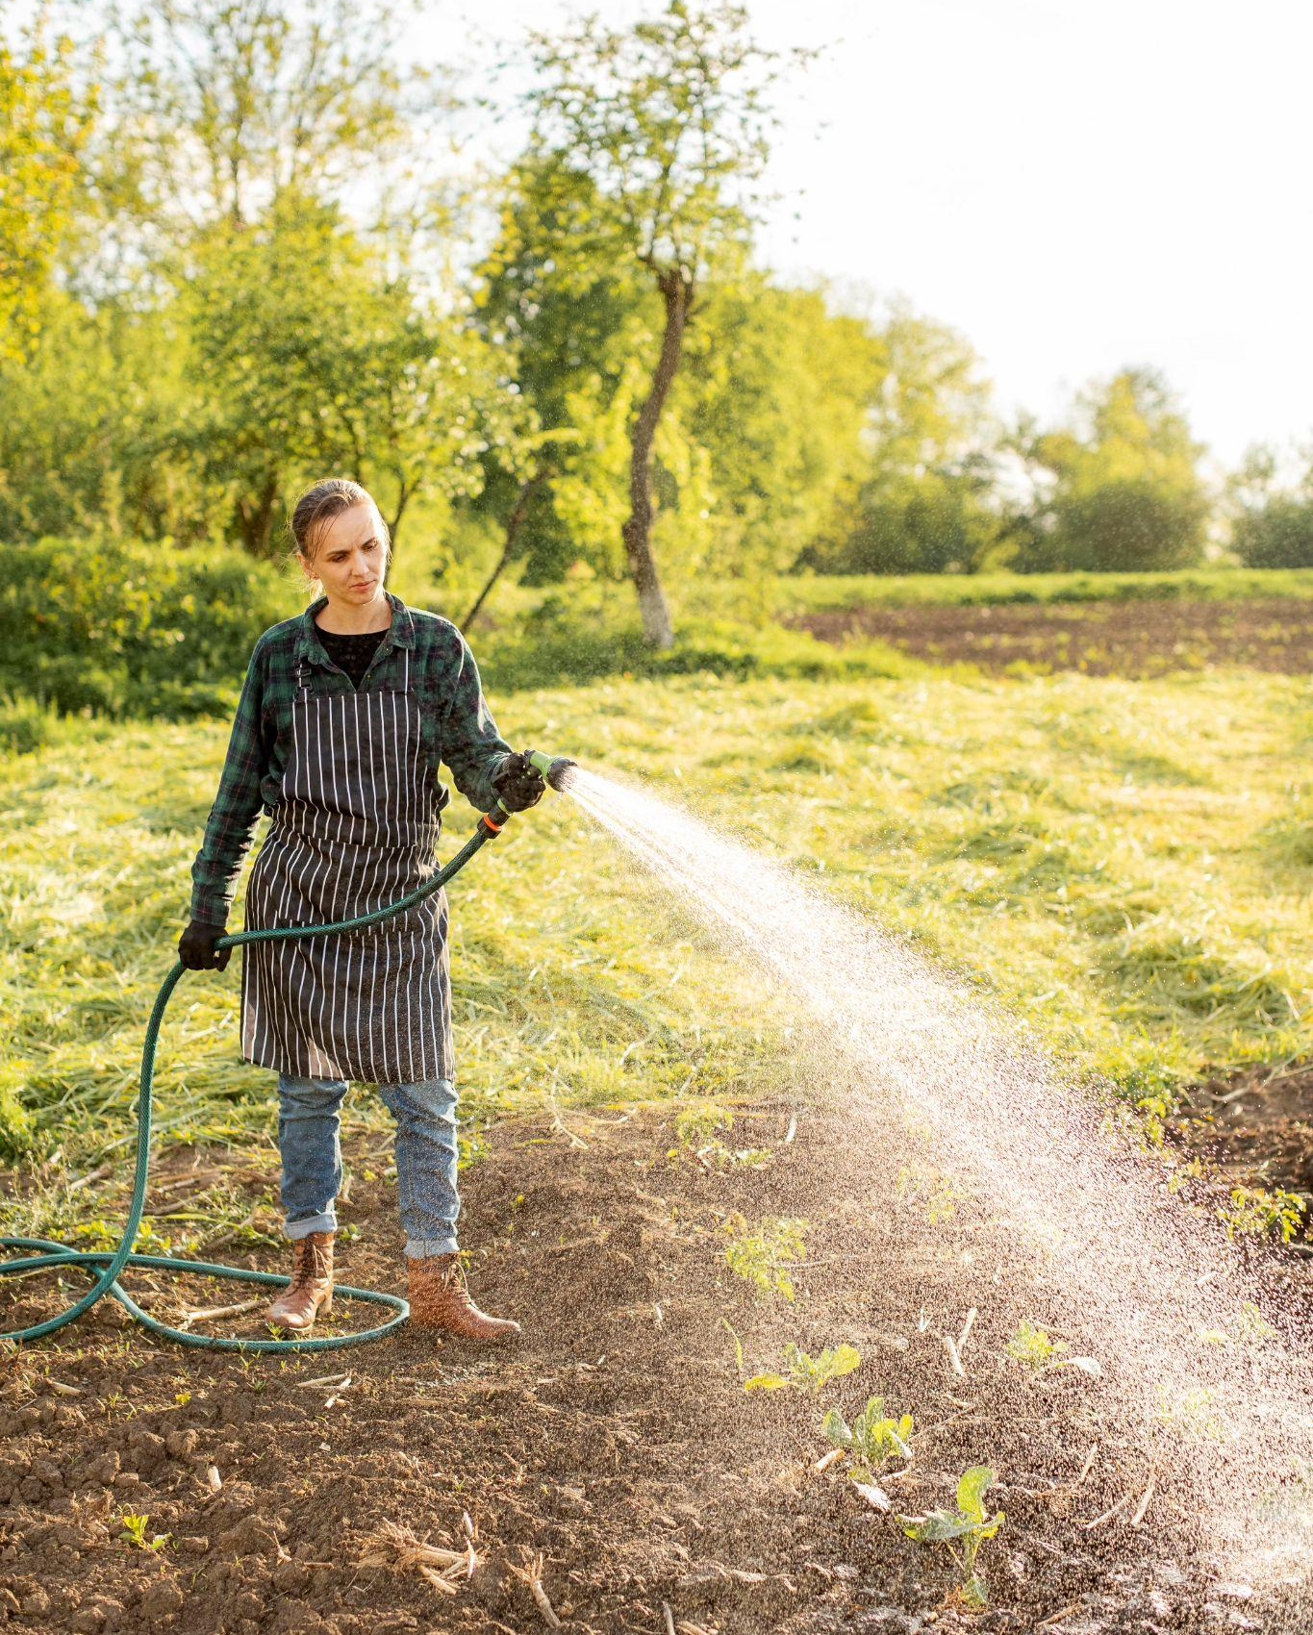
SOLUTION ??
We present to you our project
AgriSaral
A platform design to empower farmers by providing them with science backed solutions
Our platform offers comprehensive soil testing service where farmers can easily request a soil test
Along with best seeds and fertilizers based on specific parameters of soil
We also offer a market place where they can purchase the recommended seeds and fertilizers directly

Slide 5
FEATURES
01
02
03
04
05
06
Easy and reliable soil testing
Personalized recommendation of fertilizers
Recommendation of compatible seeds
Affordable and reliable marketplace
Genuine service in local language
Rich library of cropping information

Slide 6
Easy and reliable soil testing
In many rural areas, farmers face significant challenges in understanding the quality of their soil,
which is critical for choosing the right crops and fertilizers
Without this knowledge, they often make decisions that lead to lower yields, increased costs, and, ultimately, reduced income.
Our platform offers a comprehensive soil testing service, where farmers can easily request a soil at thencpmfort of their homes test by signing in on our website.

Slide 7
Personalized recommendation of fertilizers & seeds
Once the soil is tested, our system provides customized recommendations on the best seeds and fertilizers based on the specific parameters of their soil.

Slide 8
Affordable and reliable marketplace
But we don’t stop there. To support the long-term success of these farmers, we offer a marketplace where they can purchase the recommended seeds and fertilizers directly.
Where all the sellers are genuine. And the seeds are very high quality HYV seeds optimized for high yields.
And the marketplace acts as a way of employment for the people where esentially they're creating self employment

Slide 9
Rich library of cropping information
Additionally, we provide a rich library of educational resources on crop management, correct use of fertilizers and common farming mistakes like growing ginger,
It requires a lot of precautions which are not known by common farmers, like:-
Even a litte access of nitrogen in fertilizer can cause the ginger to rot or not leaving a hole while burying it can it to suffocate and consideration the investment ginger is a pretty expensive crop to afford losses

Slide 10
Genuine service in local language
And Most importantly all the information along with the GUI would be localized based in the farmers native languages to ensure accessibility and understanding.
And language would not be a barrier

Slide 11
Timeline of Development
SRS preaparation
Backend Development
Frontend Development
Logistics and e-commerce setup
Millions of farmers happy
Public release
Beta testing
Adding local language support

Slide 12
Our Team:
Neel Patel
Harshit Raval
Arman Sunasara
Heet Rana

Slide 13
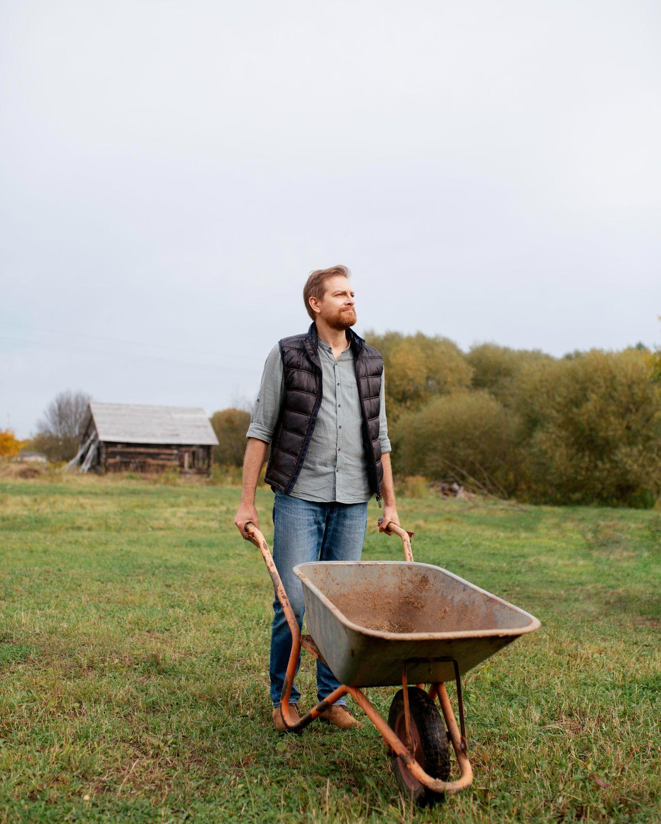
Thanks!

